Slide 1
Electric Potential Energy

Slide 2


Gravitational Potential Energy
A
$$GPE=mgΔh$$
$$GPE=mghB –mghA$$
Since: $Work=Energy$
  $$−W=FgΔh$$
$$F_{g} = mg$$
h_{A}
B
h_{B}

Slide 3





Electric Potential Energy (EPE)
+ + + + + + + + +
Since the electric field is uniform between the two plates, the force acting on the proton will be the same everywhere.
  Compare to $W = FgΔh$
A
+
F_{e} = q_{o}E
$$−W_{E(AB)}=F_{e}∆d$$
$$−W_{E(AB)}=F_{e}d_{B}–F_{e}d_{A}$$
d_{A}
$$−W_{E(AB)}=q_{o}{Ed}_{B}–q_{o}{Ed}_{A}$$
B
+
And since work = energy…
d_{B}
F_{e} = q_{o}E
$$∆EPE=q_{o}E∆d$$
- - - - - - - - - -
Does a proton at rest at point A have more or less potential energy than it would at point B?
More

Slide 4

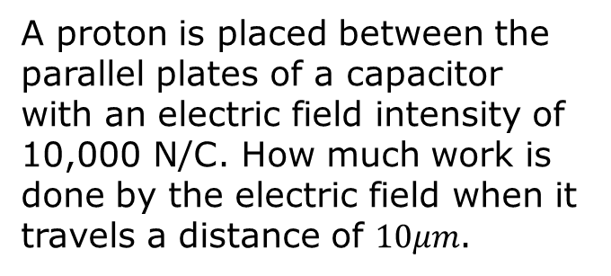


Example #1:
+ + + + + + + + +
A proton is placed between the parallel plates of a capacitor with an electric field intensity of 10,000 N/C. How much work is done by the electric field when it travels a distance of $10μm$.
A
+
F_{e} = q_{o}E
$$∆EPE=q_{o}{Ed}_{B}–q_{o}{Ed}_{A}$$
d_{A}
B
+
$$−W=∆EPE=q_{o}E∆d$$
d_{B}
F_{e} = q_{o}E
$$−W=1.6×{10}^{−19}C×10,000N/C×0.000010m$$
- - - - - - - - - -
$$W=−1.6×{10}^{−20}J$$

Slide 5
Electric Potential Energy of Point Charges
Much like the book is attracted to the earth due to gravity, two unlike charges are attracted to one another.
Conversely, like charges repel.
It takes positive work to move unlike charges away from one another and negative work to move them closer together.
-q_{o}
E
r
+q

Slide 6
Electric Potential Energy and Work of Point Charges
In order to change the electric potential energy of a system of charges, work must be done.
-q_{o}
Therefore...
-q_{o}
r_{B}
r_{A}
+q
+q
A
B

Slide 7
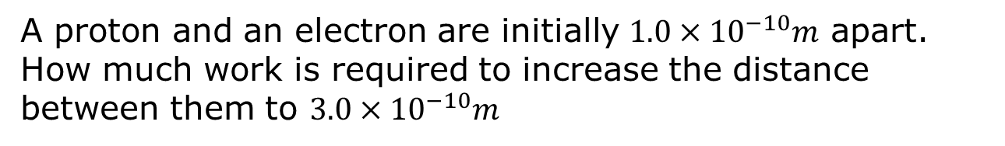
Example #2:
A proton and an electron are initially $1.0×{10}^{−10}m$ apart. How much work is required to increase the distance between them to $3.0×{10}^{−10}m$
-q_{o}
Note that you cannot take the difference between r_{B} and r_{A}.
-q_{o}
r_{B}
r_{A}
+q
+q
A
B

Slide 8
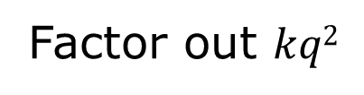


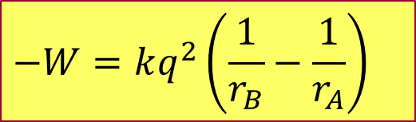
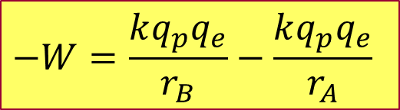
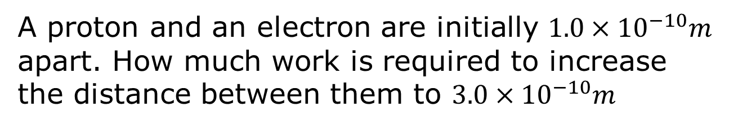
Example #2 (Cont.):
A proton and an electron are initially $1.0×{10}^{−10}m$ apart. How much work is required to increase the distance between them to $3.0×{10}^{−10}m$
$$−W=\frac{kq_{p}q_{e}}{r_{B}}−\frac{kq_{p}q_{e}}{r_{A}}$$
$$qp=qe=q$$
$$−W=kq^{2}\left(\frac{1}{r_{B}}−\frac{1}{r_{A}}\right)$$
Factor out $kq2$
$$−W=\left(9.0×{10}^{9}N\frac{m^{2}}{C^{2}}\right){\left(1.6×{10}^{−19}C\right)}^{2}×\left(\frac{1}{3.0×{10}^{−10}m}−\frac{1}{1.0×{10}^{−10}m}\right)$$
$$∆EPE=1.5×{10}^{−18}J$$

Slide 9
Electric Potential Energy
What would happen if the charged particle q was fixed in place and then particle q_{o} was suddenly released from rest?
It would accelerate away from q.
It would accelerate towards q.
It would stay where it is.
How would the potential energy of this
system change?
It would increase.
It would decrease.
It would remain the same.
-q_{o}
+q

